Slide 1
Visug XL
Executing Complex Processes with Azure Durable Functions
Jerry Van Echelpoel

Slide 2
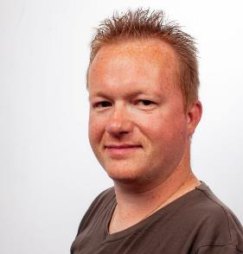


Hi, I am Jerry!
Active in IT since 2006
.NET Software Architect @ Inetum
Technical Lead DevOps-Team Zanzibar
Trying to provide simple solutions to complex problems
jerry.vanechelpoel@inetum-realdolmen.world
www.linkedin.com/in/jerryvanechelpoel

Slide 3

What are you going to learn today?
Complex processes
Azure Functions
Azure Durable Functions

Slide 4
Complex processes
Chapter
01

Slide 5

What is a complex process?
System of seperate series of events or actions
Relate to each other
Create a larger whole
Carried in a specific order
Achieve a particular result

Slide 6


Examples
Synchronisation processes
Specific order
Retrieve dataset 1
Process dataset 1
Synchronise dataset 1
Retrieve dataset 2
Process dataset 2
Synchronise dataset 2
...
Dealing with pagination
Document generation
Retrieve data
Process data
Create documents

Slide 7
Azure Functions
Chapter
02

Slide 8
What are Azure Functions?

Slide 9
Azure Functions
Serverless solution
Focus on code
Infrastructure is taken care of for you
Supports multiple platforms and languages
Event driven through triggers
Cheap

Slide 10
Limitation
Default execution time: 5 minutes
Can be increased to 10 minutes
Premium: minimum 30 minutes, without maximum (expensive)
➔ Could be a problem when it comes to time consuming processes

Slide 11
Azure Durable Functions
Chapter
03

Slide 12
What are Durable Azure Functions?
Feature of Azure Functions
Built upon Durable Task Framework
Microsoft.Azure.Functions.Worker.Extensions.DurableTask
Stateful workflows by using event sourcing
Components
Orchestrator
Activities
Supports different application patterns

Slide 13
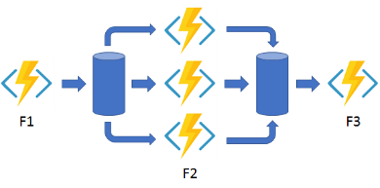
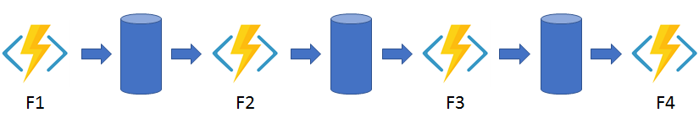
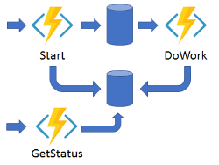

Application patterns
Function chaining
Fan out/fan in
Async HTTP APIs
Monitor

Slide 14
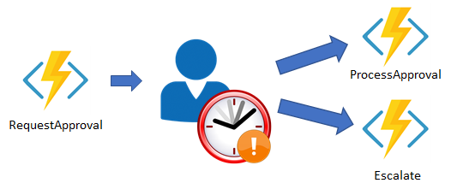

Application patterns
Human interaction
Aggregator

Slide 15
Components
Durable Client
Orchestrator
Activities
Killswitch
➔ Structure is more or less the same as a normal function

Slide 16
Durable Client
Provides an entry point to start an orchestration
Requires
Event Trigger
DurableClient
DurableClient
Controls the lifetime of an orchestration

Slide 17
Orchestrator
Define the workflow in procedural code
➔ Schedules activities
Requires
OrchestrationTrigger
Context the orchestration is running in
Able to start activities
Constraints
Async API-calls → only for starting activities = scheduling
DateTime/GUID/UUID → use context instead
…

Slide 18
Activity
Provides a single functionality in the orchestration
➔ Acts as a normal function
Requires
ActivityTrigger → Provide parameters

Slide 19
Killswitch
Provides a means to Terminate an orchestration
Useful in development
Avoids cleaning of orchestration state in Storage Account
Optional component
Requires
Event Trigger (Http)
DurableClient

Slide 20
Links
Durable Functions: Application Patterns
GitHub - ComplexProcessesWithDurableFunctions

